Slide 1
FIFA WORLD CUP ANALYSIS
BY,
NANDANA GRACE JOHNY

Slide 2
INTRODUCTION
The FIFA World Cup is a global football competition contested by the various football-playing nations of the world.
It is contested every four years and is the most prestigious and important trophy in the sport of football

Slide 3
PROJECT DETAILS
Technologies – Data Science
Domain - Sports

Slide 4
TOOLS USED
Microsoft Excel
Microsoft Power BI

Slide 5
DETAILS OF DATA
WORLD CUP MATCHES
WORLD CUP PLAYERS
WORLD CUP

Slide 6
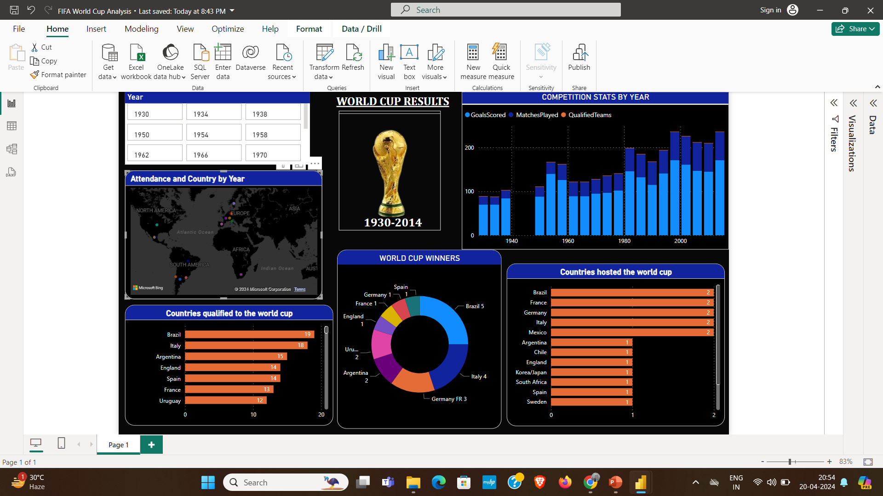
MY DESIGN

Slide 7
CONCLUSION
Brazil has qualified for the FIFA World Cup 19 times.
Brazil has hosted the World Cup twice, followed by France has hosted it twice as well
The sum of goals scored in the 2014 World Cup is 171.
In 2014, a total of 32 teams qualified, playing a total of 64 matches.
Germany recorded the highest attendance among all countries.

Slide 8
THANK YOU

